Slide 1
Normalization

Slide 2
Lecture - Objectives
Normalization
Well-Structured Relation
Anomalies
Functional Dependency
How to identify functional dependencies for a given relation.
Steps in Normalization
First Normal Form

Slide 3
Normalization
The process of decomposing relations with anomalies to produce smaller, well-structured relations.
Primarily a tool to validate and improve a logical design so that it satisfies certain constraints that avoid unnecessary duplication of data

Slide 4
Well-Structured Relations
A relation that contains minimal data redundancy and allows users to insert, delete, and update rows without causing data inconsistencies.
Goal is to avoid anomalies
Insertion Anomaly–adding new rows forces user to create duplicate data
Deletion Anomaly–deleting rows may cause a loss of data that would be needed for other future rows
Modification Anomaly–changing data in a row forces changes to other rows because of duplication
General rule of thumb: A table should not pertain to more than one entity type

Slide 5
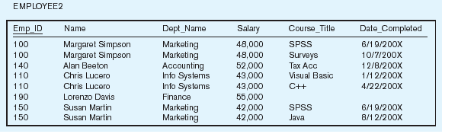
Relation but not Well-Structured Relation

Slide 6
Anomalies in this Table
Insertion–can’t enter a new employee without having the employee take a class
Deletion–if we remove employee 140, we lose information about the existence of a Tax Acc class
Modification–giving a salary increase to employee 100 forces us to update multiple records
Why do these anomalies exist?
Because there are two themes (entity types) in this one relation. This results in data duplication and an unnecessary dependency between the entities

Slide 7
Well-Structured Relation

Slide 8
Well-Structured Relation

Slide 9
Functional Dependencies and Keys
Functional Dependency:
A constraint between two attributes in which the value of one attribute is determined by the value of another attribute.
The functional dependency of B on A is represented
by an arrow, as follows: A → B
The attribute on the left side of the arrow in a functional dependency is called a determinant.

Slide 10
Functional Dependency in Employee1
EmpID → Name, DeptName, Salary
Functional Dependency Diagram:

Slide 11
Functional Dependencies and Keys
Candidate Key: A candidate key is an attribute, or combination of attributes, that uniquely identifies a row in a relation.
A unique identifier. One of the candidate keys will become the primary key
E.g. perhaps there is both credit card number and SS# in a table…in this case both are candidate keys
Each non-key field is functionally dependent on every candidate key

Slide 12
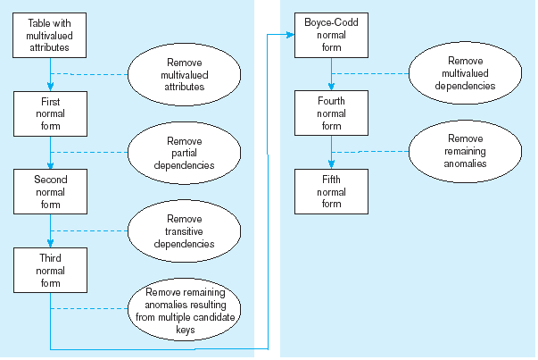
Steps in Normalization

Slide 13
First Normal Form
A relation that has a primary key and in which there are no repeating groups.
No multivalued attributes
A primary key has been defined
All relations are in 1st Normal Form

Slide 14
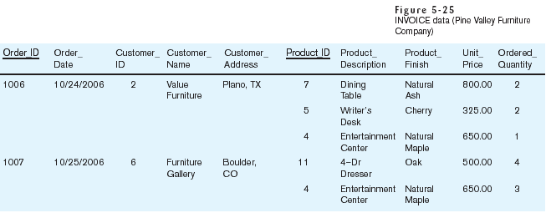
Table with multivalued attributes, not in 1st normal form
Note: this is NOT a relation

Slide 15
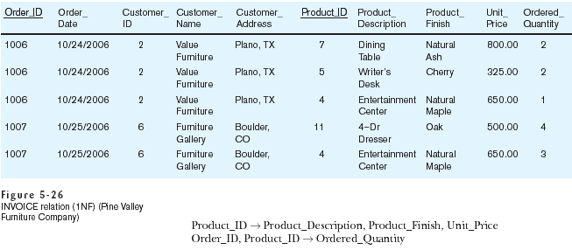
Table with no multivalued attributes and unique rows, in 1st normal form
Note: this is relation, but not a well-structured one

Slide 16
Anomalies in this Table
Insertion–if new product is ordered for order 1007 of existing customer, customer data must be re-entered, causing duplication
Deletion–if we delete the Dining Table from Order 1006, we lose information concerning this item's finish and price
Update–changing the price of product ID 4 requires update in several records
Why do these anomalies exist?
Because there are multiple themes (entity types) in one relation. This results in duplication and an unnecessary dependency between the entities

Slide 17
Thanks

